Slide 1

Car Work!
Workshop M.T.E Project
Submitted To
Mr. Girish Kumar
Submitted By
Parth Johri 2K20/B17/33
Dhruv Bihani 2K20/B17/44

Slide 2

Welcome!
We’re glad to have you here.

Slide 3
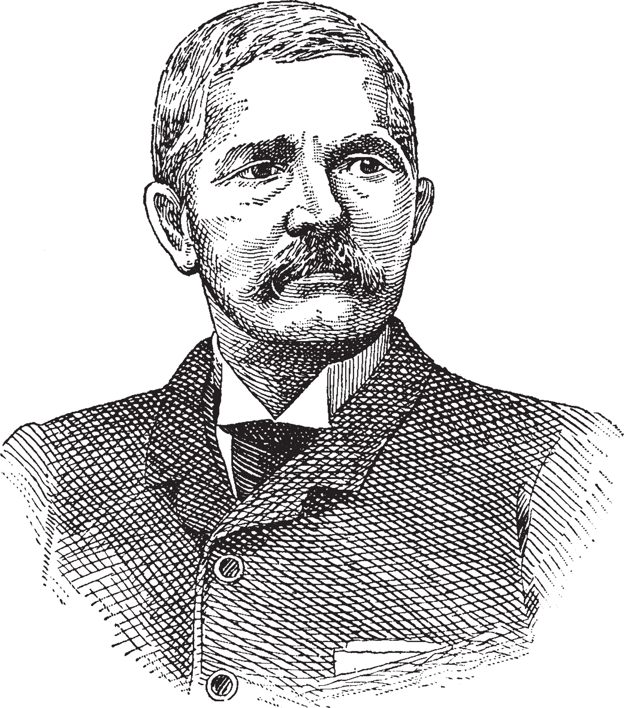
Introduction
In 1908 Henry Ford began production of the Model T automobile. Based on his original Model A design first manufactured in 1903, the Model T took five years to develop. Its creation inaugurated what we know today as the mass production assembly line. This revolutionary idea was based on the concept of simply assembling interchangeable component parts. Prior to this time, coaches and buggies had been hand-built in small numbers by specialized craftspeople who rarely duplicated any particular unit. Ford's innovative design reduced the number of parts needed as well as the number of skilled fitters who had always formed the bulk of the assembly operation, giving Ford a tremendous advantage over his competition
Automobile , by name auto also called motorcar or car , a usually four-wheeled vehicle designed primarily for passenger transportation and commonly propelled by an internal-combustion engine using a volatile.

Slide 4
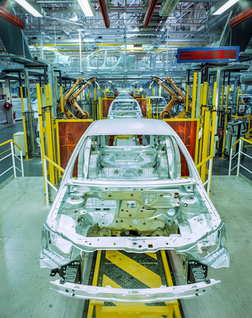
BODY
The design of a car body is often divided into the number of doors, the layout of the seats and the design of the roof. The roof of the car is supported by pillars on each side of the body.The bodies of the cars are usually made of steel. Metal is mixed with various materials to improve its ability to form at deep depths without cracks or cracking in production machinery. The metal is used because of its common availability, low cost, and efficient performance. In some applications, however, other materials, such as aluminum, fiberglass, and carbon-fiber-reinforced plastic, are used because of their special properties. Polyamide, polyester, polystyrene, polypropylene, and ethylene plastic are designed for high durability, crack resistance, and resistance to harmful deformities. These materials are used for body panels.

Slide 5
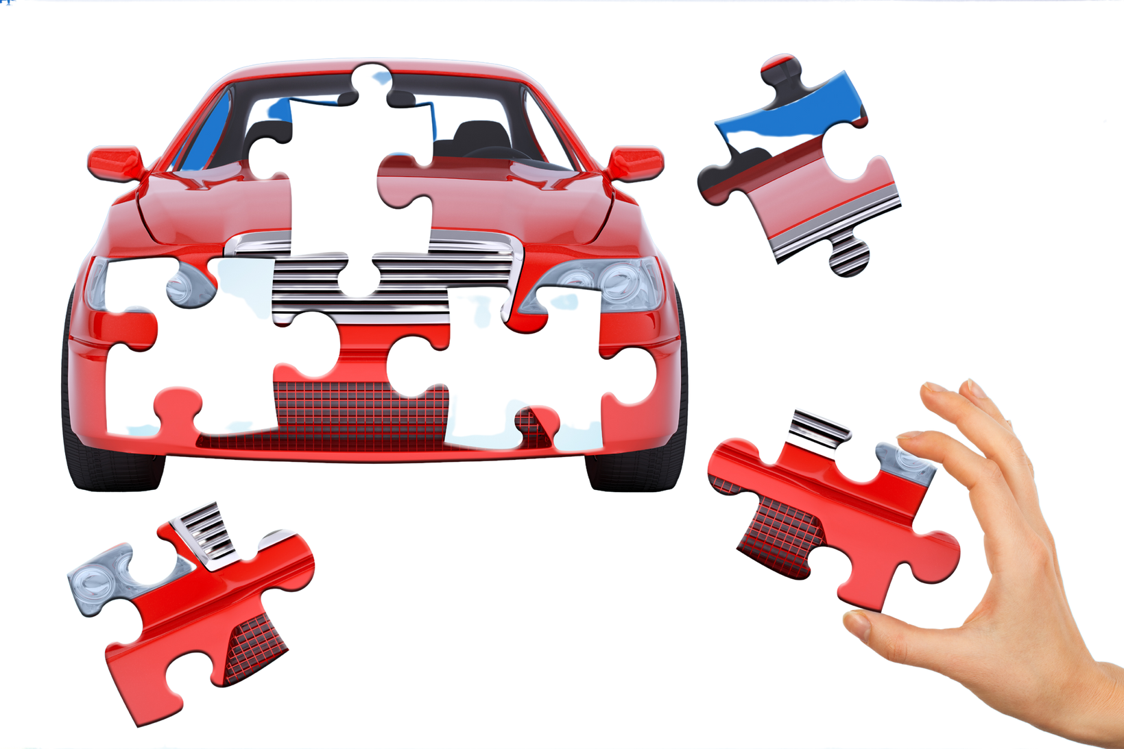
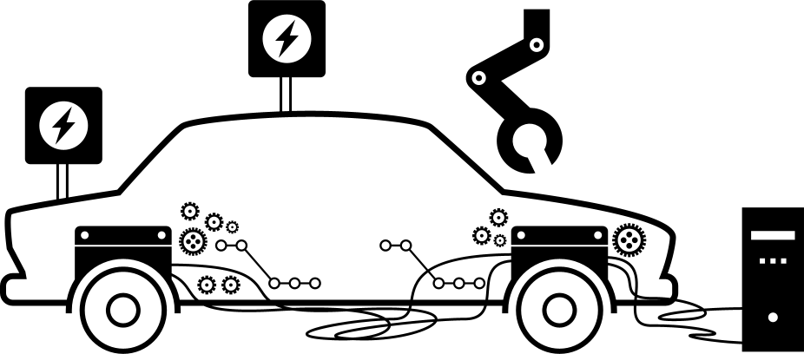
PROCESS OF MAKING A CAR
The process of making a car can be roughly divided into
STAMPING
WELDING
PAINTING
ASSEMBLY
INSPECTIONS
which takes about 17-18 hours in total.
(It varies according to the number of cars made by a factory.)
When we consider that each car is made of about 30,000 parts, each of which takes time to produce, the time it takes to build a car is quite long

Slide 6

Vehicle body – is most expensive part of a car. Vehicle body could be the main supporting structure or its particular element.
The Vehicle Body of modern car consist of: engine section, saloon, trunk.
Vehicle body is the main supporting structure of a vehicle, to which all other components are attached. Truck uses a separate frame as chassis.
VEHICLE
BODY
CONSTRUCTION
1 – FRONT SPAR
2 – FRONT PANEL
3 – SCREEN PILLAR
4 – ROOF PANEL
5 – REAR QUARTER PANEL
6 – BODY QUARTER
7 – PANEL TRUNK
8 – CENTER PILLAR
9 – SILL
10–CENTRE TUNNEL
11 – BASE
12 – SCUTTLE
Vehicle body is designed for carry the goods (a truck) or for carriage of passengers (passenger car). There are some kinds of vehicle body which differ in: by purpose (trucks, passengers, cargo-passenger, special) and by construction (skeleton, half-skeleton, non-skeleton).

Slide 7
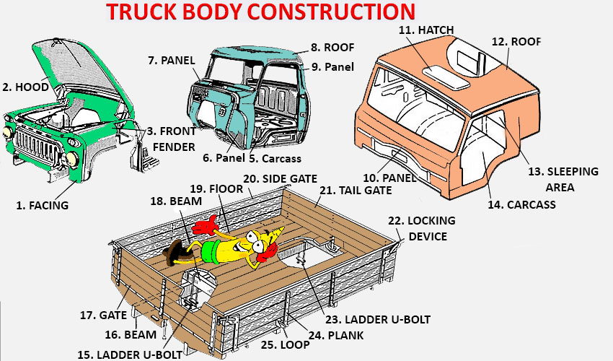
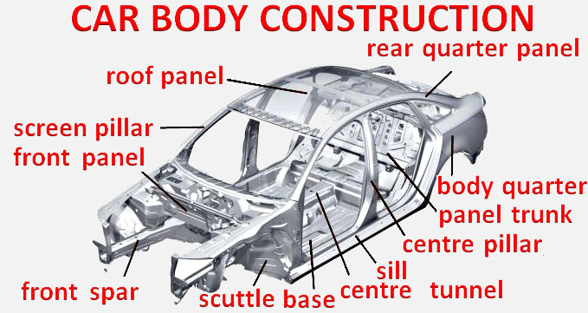
BODY CONSTRUCTION

Slide 8

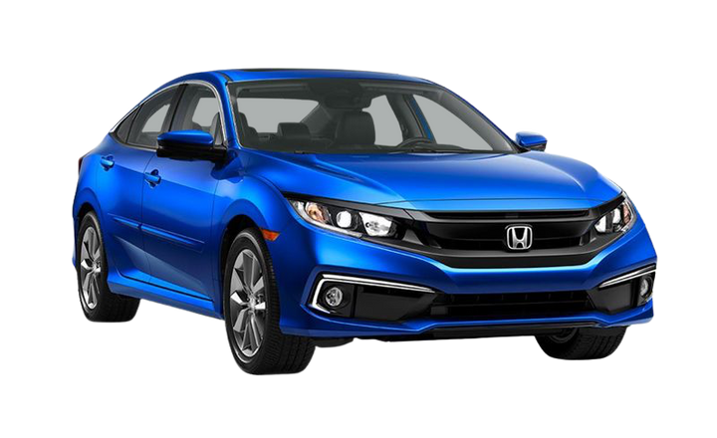
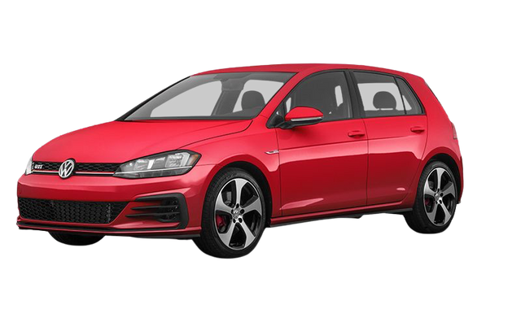
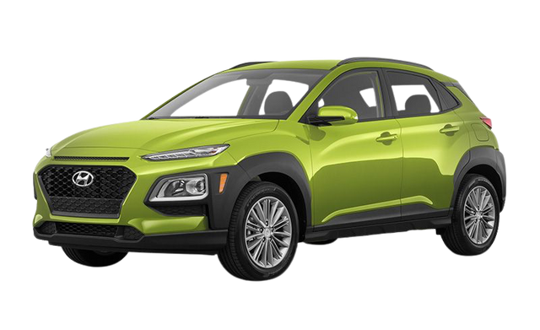
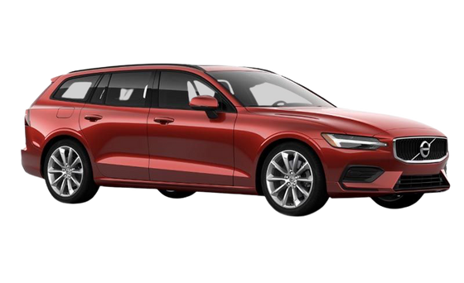
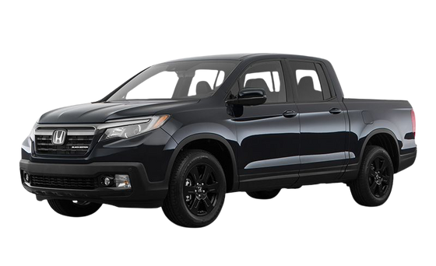
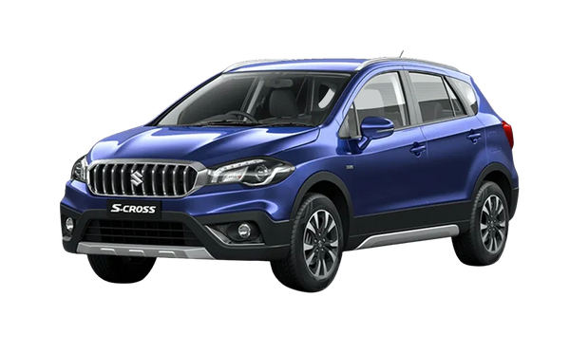
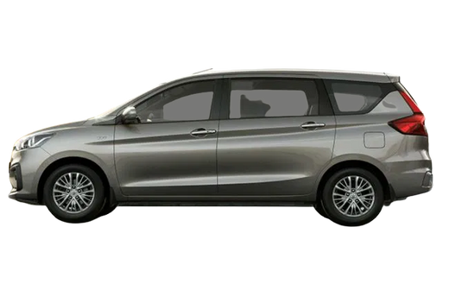
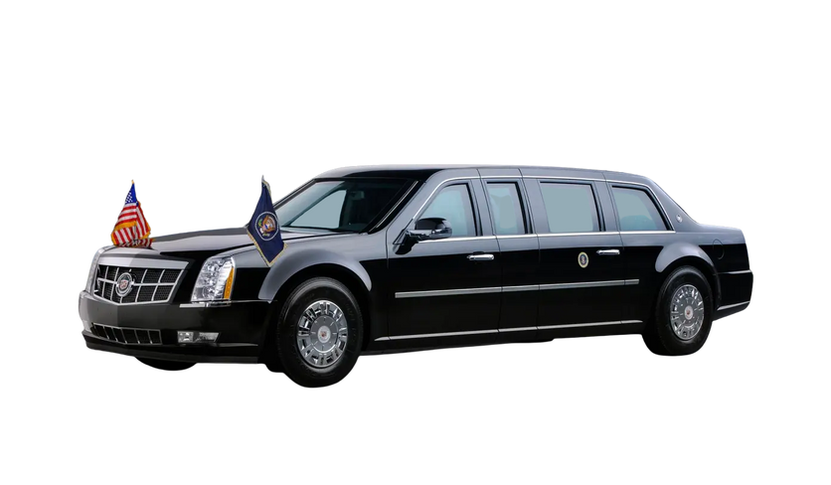
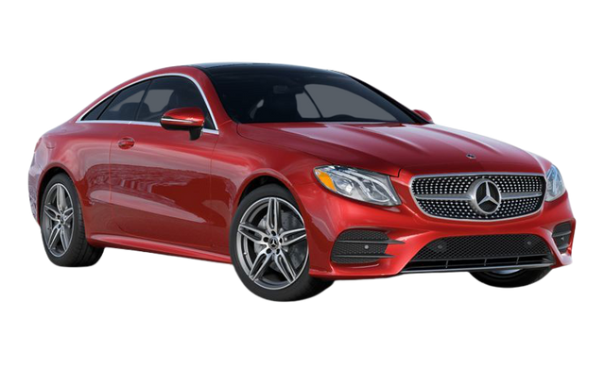
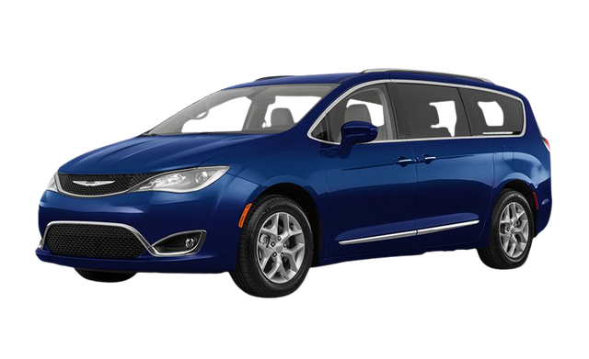
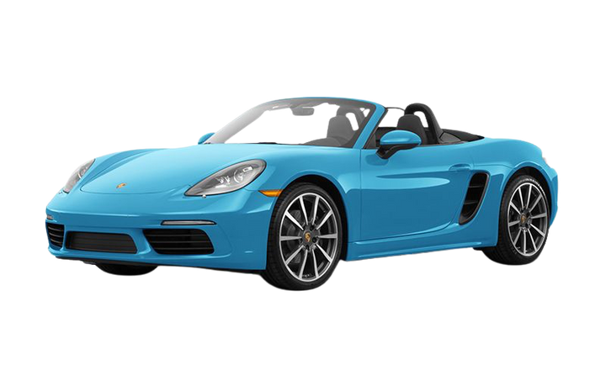
THE DIFFERENT STYLES OF CAR BODY TYPES
SUV/Compact SUV (Sports Utility Vehicle)
Hatchback
Sedan/Compact Sedan
Station Wagon/ Estate Cars
Pick-up trucks
Crossovers
MPV (Multi-Purpose Vehicle)
Limousines
Coupe
Mini Vans
Convertibles/ Cabriolet/ Spyder

Slide 9


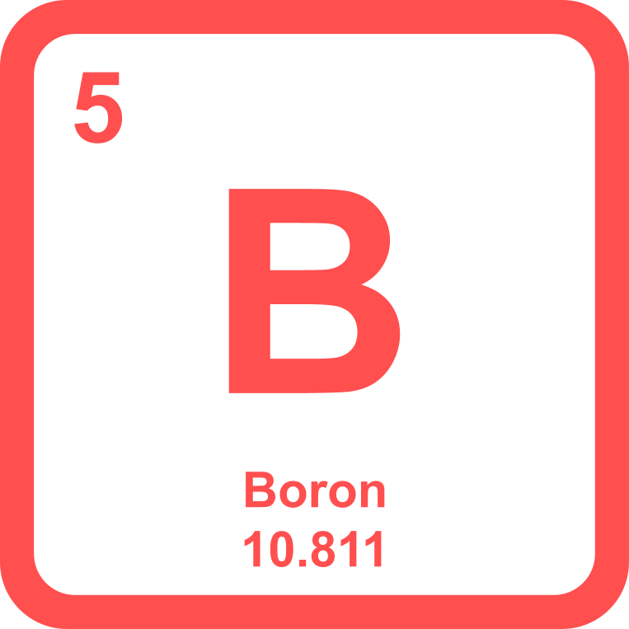
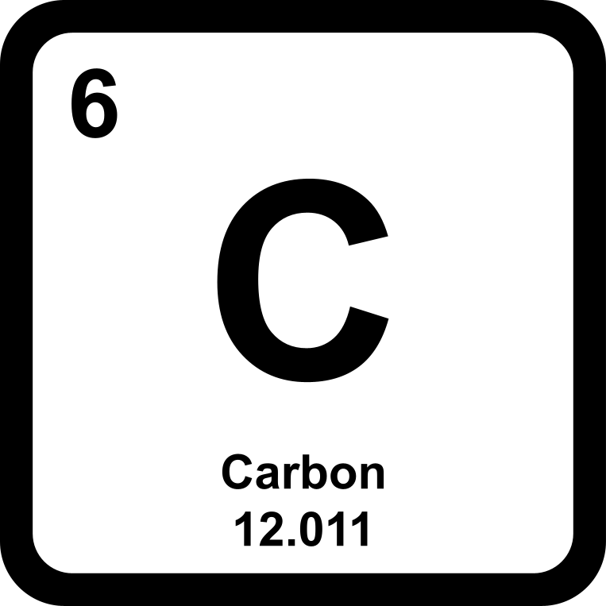
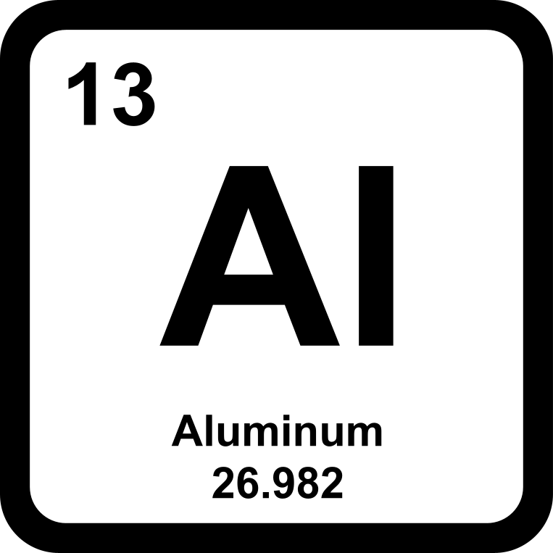
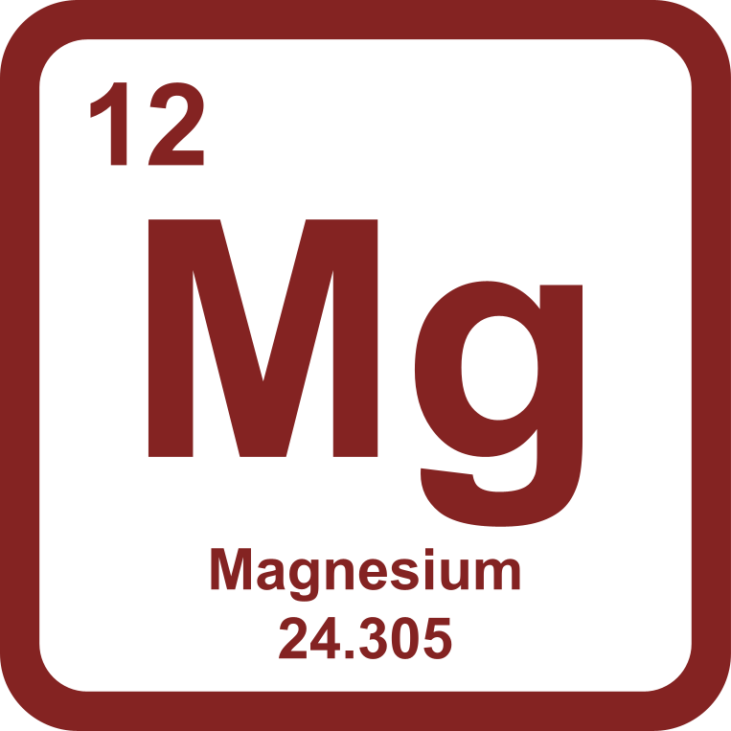
COMMONLY USED AUTOMOTIVE MATERIALS
Mild Steel: Mild steels are easy to form, which makes them a top choice for automotive parts manufacturers using cold stamping and other dated manufacturing processes. They have a maximum tensile strength of 270 MPa.
High Strength Low Alloy (HSLA): HLSAs are carbon manganese steels strengthened with the addition of a micro alloying element such as titanium, vanadium, or niobium. These have a tensile strength up to 800 MPa, and can still be press formed.
Ultra High Strength Steel (UHSS): These follow similar properties as AHSS, but maintain strength levels of at least 780MPa.
Boron/Martensite: Martensite is the hardest and strongest form of steel, but it’s also the least formable. It shares properties with boron, which has a tensile strength of around 1,200 to 1,800 MPa. These are usually combined with softer steels to form composites.
Aluminum 5000/6000 (AL 5000/6000): 5000-series aluminium is alloyed with magnesium. 6000-series aluminium contains both silicon and magnesium which forms magnesium silicide and makes the aluminium alloy heat-treatable.
Magnesium: Magnesium is an attractive material for automotive use because of its light weight. When alloyed, magnesium has the highest strength-to-weight ratio of all structural metals.
Carbon Fiber Reinforced Plastic (CFRP): CFRPs are extremely strong, light plastics which contain carbon fibers to increase strength. They are expensive to produce but will have a growing demand in the future automotive industry as costs are reduced.

Slide 10

PROCESSES USED IN CAR MANUFACTURING

Slide 11

In bending, force is applied to a sheet metal workpiece to produce curvature of the surface. Bending is generally used to produce simple curved surfaces rather than complex ones.
A mechanically operated press drives a punch against sheet metal, forcing it into a simple die with enough pressure to produce a permanent change in the metal's shape. The amount of pressure is important. If not enough pressure is applied, the metal can simply spring back into its original shape. If too much is applied, it can break.
BENDING

Slide 12
In the drawing, the sheet metal is forced against a die that has been cut into the three-dimensional, often curved shape that the sheet metal is to take on. In effect, the die is used as a mold for the metal. This technique can produce relatively complex shapes. Once again, pressure is applied to the workpiece using a hydraulically or mechanically operated punch. There are a number of dangers involved, not so much to people (since the process is largely mechanized) but to the metal itself. It can crack from too much pressure or wrinkle from its interaction with the die. Lubricant can be used to make the metal slide more smoothly against the die, avoiding the possibility of wrinkling. Alternatively, the wrinkled edges can be trimmed from the metal in a separate operation. This method is commonly used to make auto body parts and fuel tanks.
DRAWING

Slide 13
STAMPING
EXTRUSION
In stamping, a device called a stamping press is used with a series of dies to cut and form metal into various shapes. This is commonly used to make auto parts such as hubcaps and fenders.
Extrusion can be used to produce long metal objects, such as rods and tubes. The metal workpiece is forced into a die with a hole in the opposite end. The metal is extruded through the hole to form the shape. Extrusion can be used to manufacture important parts of a car's drive train or the anchors that hold seatbelts in place.

Slide 14
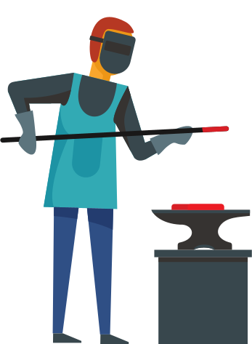
FORGING
The forging process uses a hammer or press that is essentially a mechanized version of the hammers used by ancient blacksmiths. The metal is hammered against a surface that serves as an anvil. It can be hammered repeatedly so as to form complex shapes. This can be used as an alternative to the drawing process.

Slide 15
3D DESIGN OF CAR BODY
DESIGNED BY US IN SOLID WORKS

Slide 16
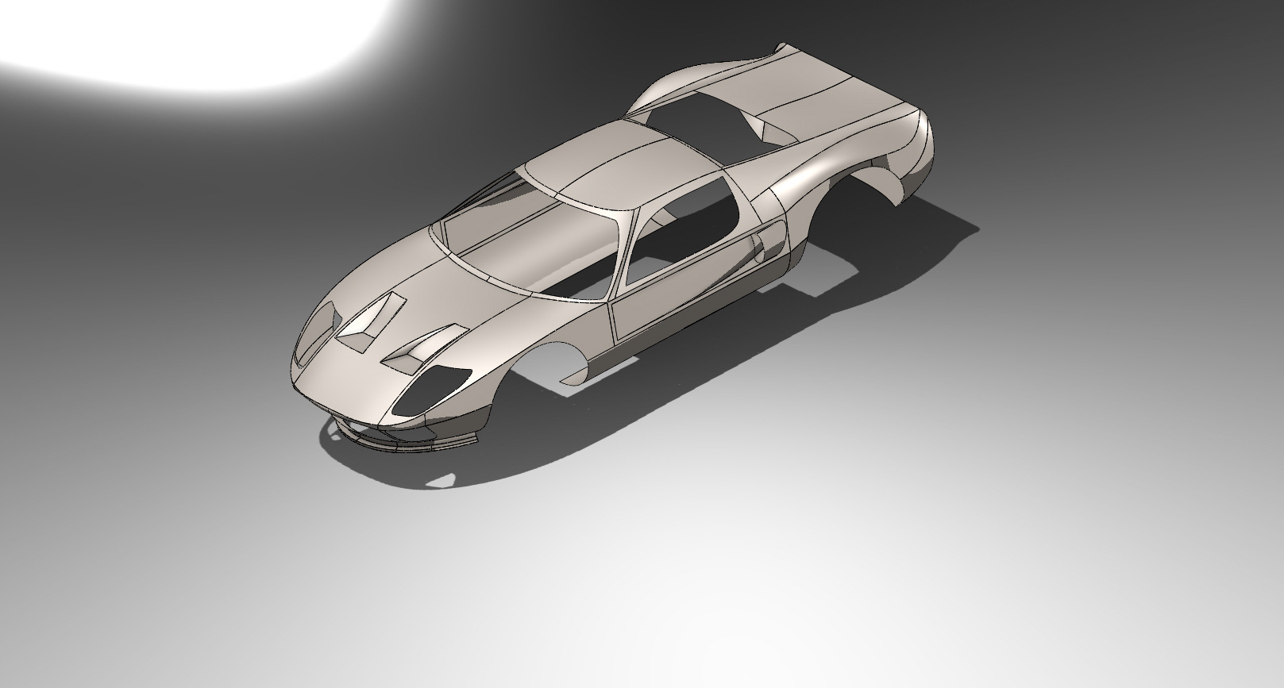

Slide 17
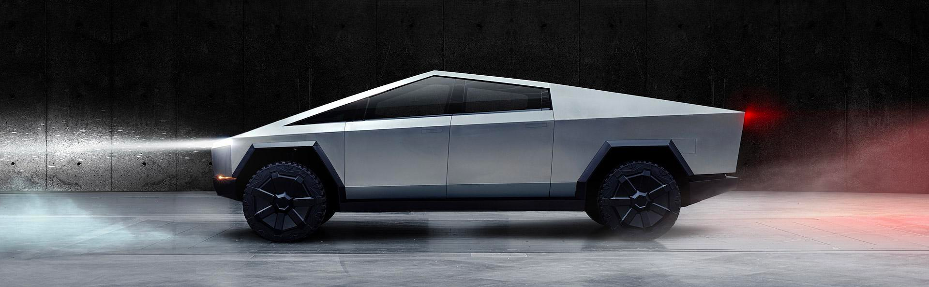
INNOVATIVE CAR DESIGN

Slide 18
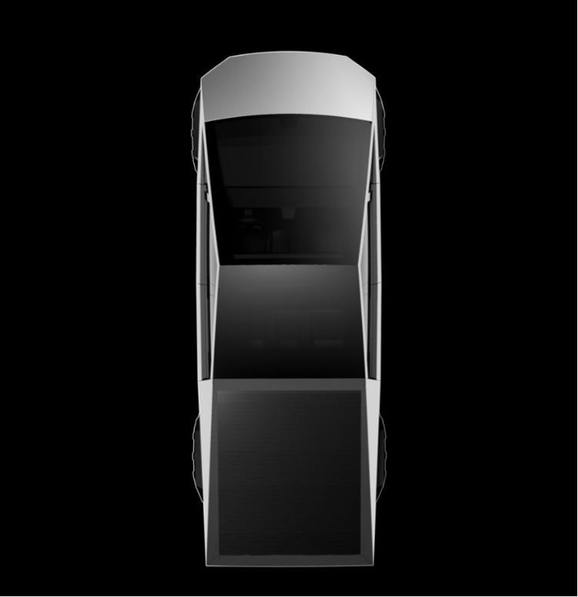
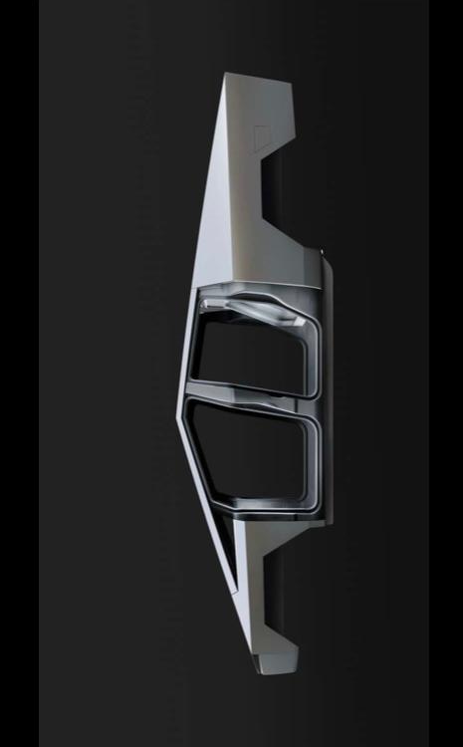
Tesla
Cybertruck
In modern day automobile market, we have many innovative design as development of science leads to revolutionary new car body . for example Elon musk Tesla launch Cyber truck, an electric powered car which is going to attract many customers in modern days.
1. It consists of unbreakable glass
2. Autopilot standard are added
Cyber truck is built with ultra durable and hard 30X Cold – Rolled Stainless steel structural with a speed of 0-60 mph.
There is no doubt Cyber truck is a futuristic mobile.

Slide 19


Cyber truck uses very hard metal to ensure proper shielding , material used is Ultra – Hard 30 X Cold – Rolled Stainless -steel structural.
The Tesla Cybertruck is so loaded that the car is almost a hidden box of hidden features.
2. The Tesla Cybertruck is fitted with three seats in the front, or center, which serves as a small jumping seat. As can be seen in the ride videos, this middle seat actually folds it into a large armchair. Interestingly, this armrest center has doubled as a warehouse. It also has three cups mounted directly on the back seat of the middle seat, and a switch holder (“junk cubby”) next to random knick knacks.
3. While its exterior has no future, is violent on the outside, the interior of Tesla Cybertruck is actually quite acceptable. As they get into the car, passengers are greeted by the interior of the cave and a large glass roof that will be a great option for those who like to camp in their car. The rear seats are also fitted with a light bulb inside the sides, which illuminates the back of the truck passengers. The lights are also white, offering an additional future, such as Tron on the outside of Cybertruck.
4. The Tesla Cybertruck has a large center armrest in the back that looks doubled as support for additional equipment. The electric-powered van already has a 6.5-meter bed, which is great, but for those who wish to pull the heaviest load, the armrest center can fold down and work as a pass of more than 6.5 meters.
5. Among Cybertruck's smartest features is its solar visor, which contrasts with the A-Pillar.
This would be especially helpful when

Slide 20
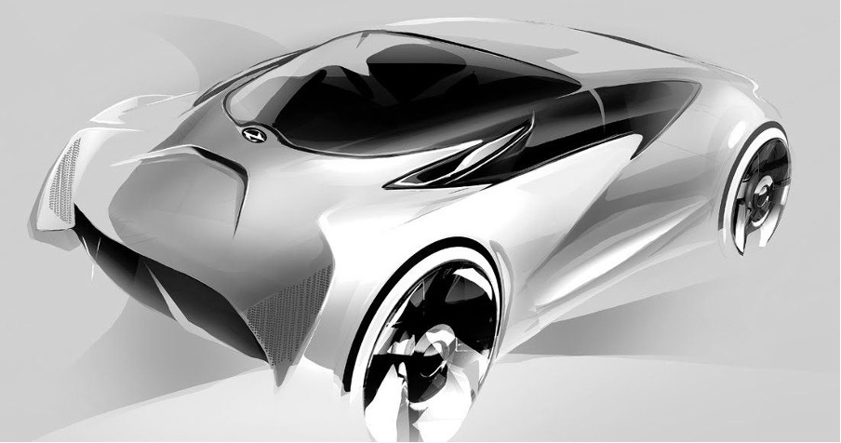
Innovative Design to watch for
As market is expanding automobile industry wants a edge over other supplier so there are some unique ideas which is going to be face for franchise in future

Slide 21
Thank you
for your time!

